Slide 1
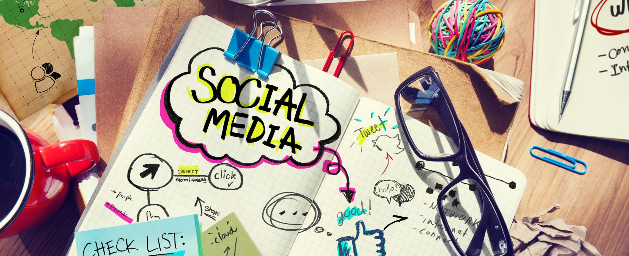
Social media and stress

Slide 2
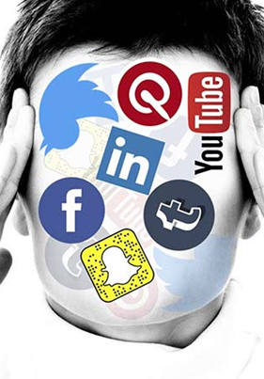
Stress
A state of worry or mental tension caused by a difficult situation. A natural human response prompting us to address challenges and threats in our lives. Everyone experiences stress to some degree. The way we respond to stress makes a big difference to our overall well-being (WHO, 2023)

Slide 3
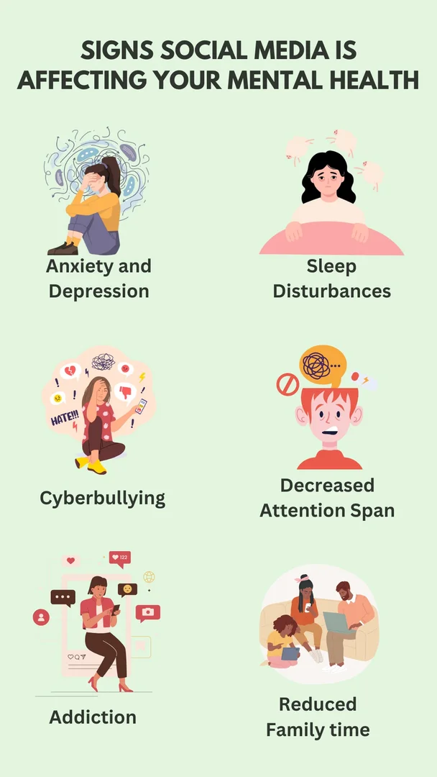
Stress and social media
Empirical studies repeatedly found positive correlations between social media use and stress. Such positive relationships could indicate that social media use causes stress or that stress triggers social media use (Wolfers and Utz, 2020)
The Likert-type scale is a widely used psychometric instrument for measuring attitudes, opinions, or perceptions in research contexts (Koo and Yang, 2025)
0 – 3 - Low
4 -7 - Moderate
> 7 - High

Slide 4
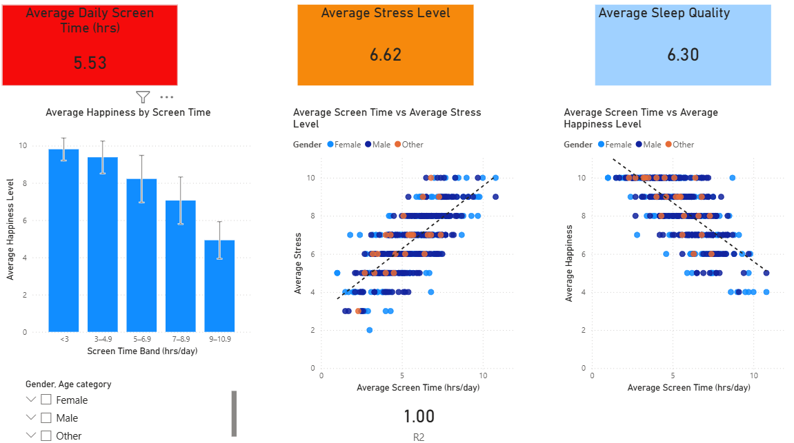

Slide 5
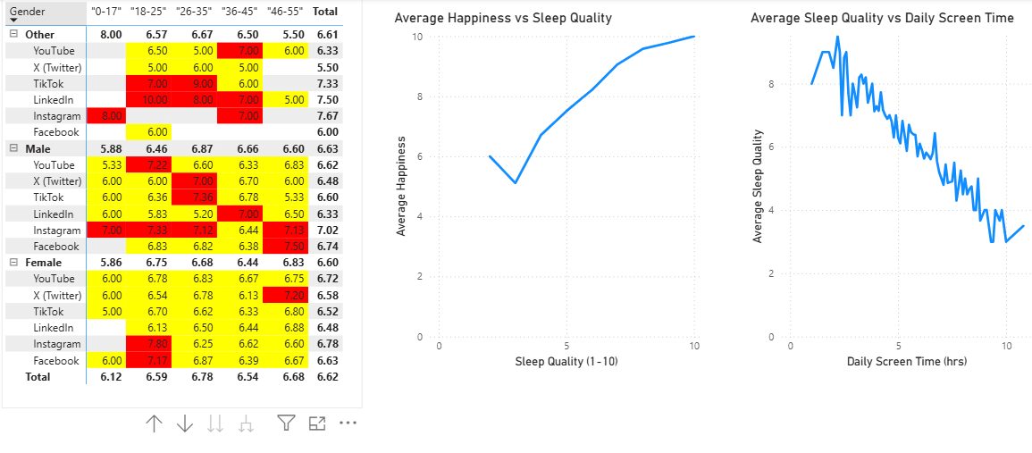

Slide 6
References
1. Wolfers, L.N. and Utz, S., 2022. Social media use, stress, and coping. Current Opinion in Psychology, 45, p.101305.
2. World Health Organization (WHO) (n.d.) Stress. World Health Organization. Available at: https://www.who.int/news-room/questions-and-answers/item/stress (Accessed: 2 December 2025).
3. Koo, M. and Yang, S.W., 2025. Likert-type scale. Encyclopedia, 5(1), p.18.
4. Imran, A. (2023) Social Media and Mental Health Balance. Kaggle. Available at: https://www.kaggle.com/datasets/ayeshaimran123/social-media-and-mental-health-balance (Accessed: 2 December 2025).

